Slide 1

Zomato Order & Restaurant Analysis Using Power BI
A comprehensive analysis of restaurant distribution, order patterns, revenue metrics, and customer behavior across major Indian cities, revealing key insights for strategic business decisions.
by Abubakkar Siddiq

Slide 2
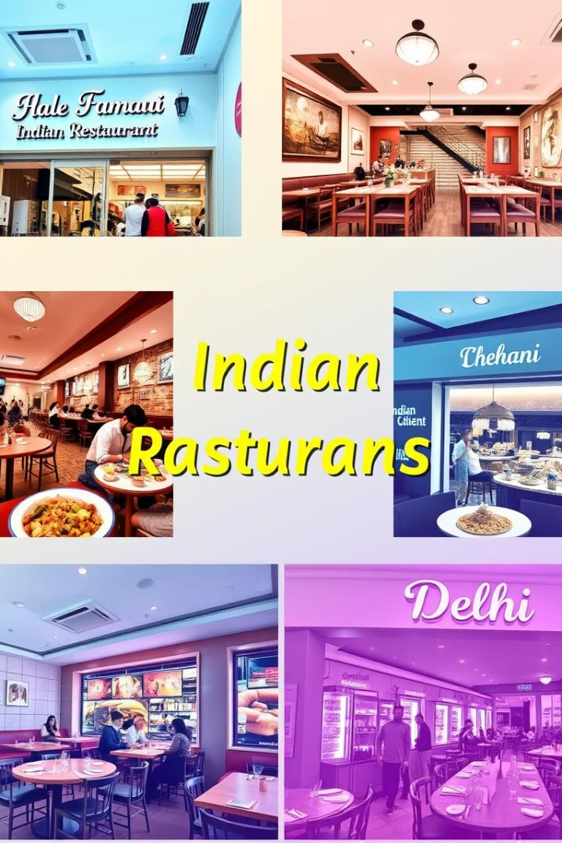
City-wise Restaurant Distribution
115
Mumbai
Highest number of restaurants
109
Bangalore
Second highest restaurant count
93
Delhi
Third in restaurant distribution
92
Kolkata
Fourth in restaurant count
The distribution shows Mumbai leading with 115 restaurants, while Bangalore follows closely with 109 establishments. Delhi, Kolkata, and Chennai have 93, 92, and 91 restaurants respectively.

Slide 3
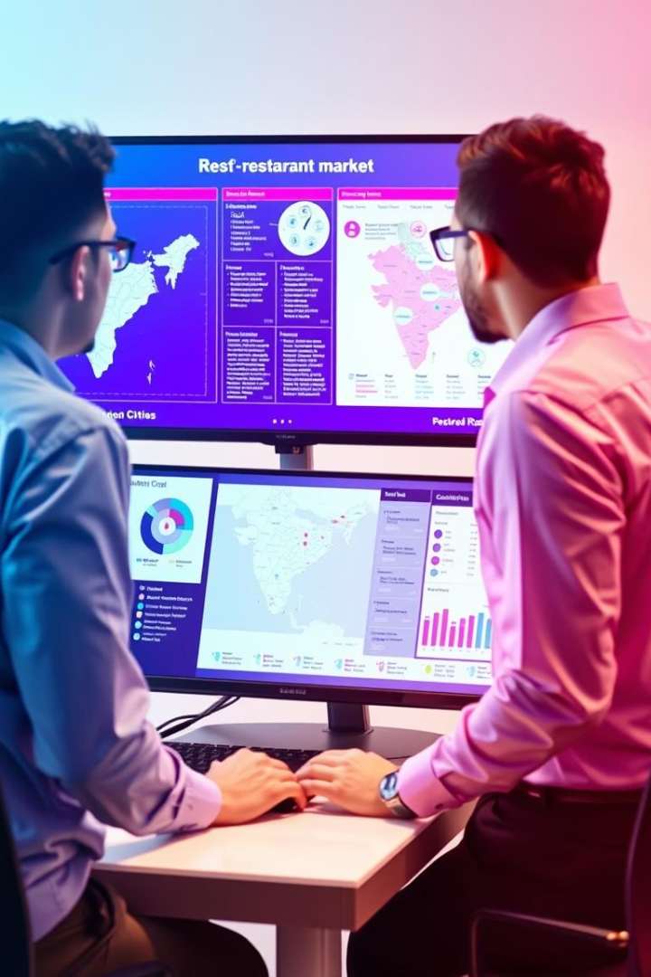
Market Analysis and Insights
Market Distribution
Restaurant distribution is quite even among the top 5 cities, with Mumbai slightly ahead, indicating a saturated but competitive market.
Mumbai's Leadership
With 115 restaurants, Mumbai maintains a slight edge over other metropolitan centers, reflecting its status as India's financial capital.
Bangalore's Growth
At 109 restaurants, Bangalore shows strong presence in the food service industry, likely driven by its tech industry and cosmopolitan population.
Competitive Landscape
The close numbers between Delhi (93), Kolkata (92), and Chennai (91) suggest similar market conditions and opportunities across these major urban centers.
Insight: Restaurant distribution is quite even among the top 5 cities, with Mumbai slightly ahead, indicating a saturated but competitive market.

Slide 4





City-Wise Order Distribution
2
Bangalore
Mumbai
22% of total orders (3.3K orders)
1
22.56% of total orders (3.38K orders)
Delhi
3
19.05% of total orders (2.86K orders)
Chennai
5
Kolkata
18.18% of total orders (2.73K orders)
4
18.21% of total orders (2.73K orders)
Insight: The order distribution is fairly balanced among cities. Mumbai and Bangalore are top performers, but Delhi is not far behind. This suggests customer demand is consistently high across these metros.

Slide 5
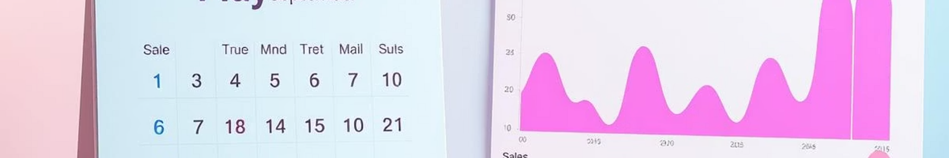
Peak and Low Sales Periods – Time-Based Order Analysis
January 2024
May 2024
Lower Sales (around $20K–$40K)
High Peak (around $70K)
1
2
3
4
March 2024
September 2024
Lower Sales (around $20K–$40K)
High Peak (around $70K)
Insight: Mid-year (summer months) and early festive seasons (September) drive higher sales volumes. Businesses could plan promotions around these peak times to maximize revenue.

Slide 6
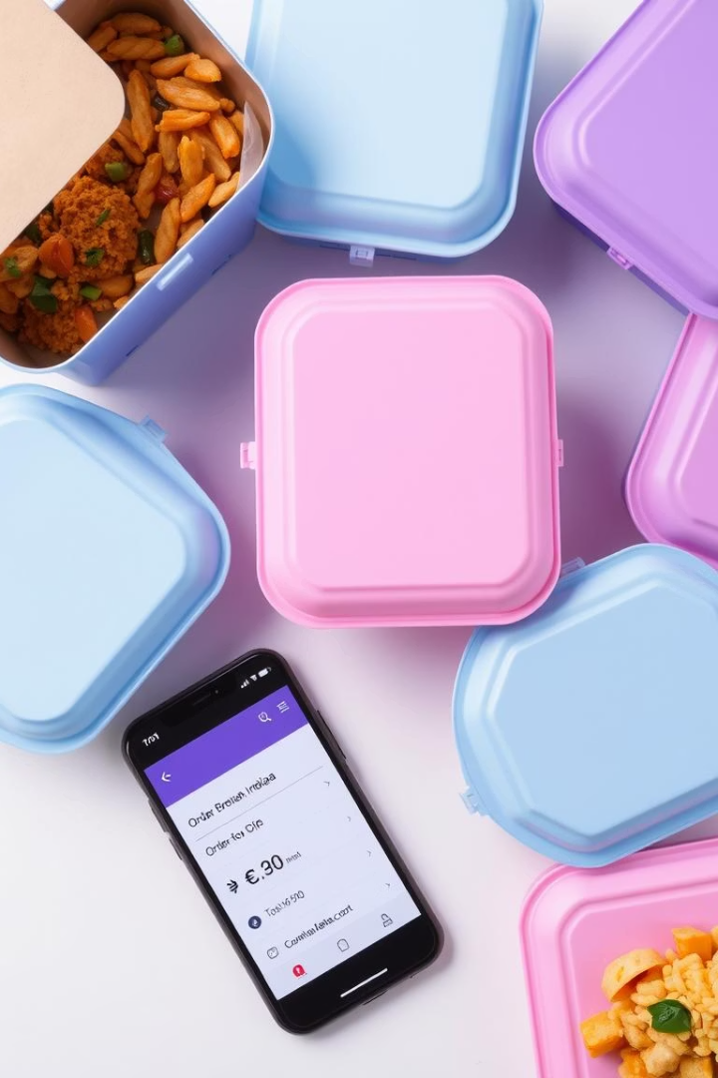
Average Order Value
Overall Average Order Value
Bangalore Efficiency
Despite similar total sales, Bangalore's slightly higher efficiency might come from higher average order values or better customer loyalty.
$1.04K
Strategic Implication
Insight: Premiumization (higher-value orders) may be a significant factor, and strategies around upselling could be further reinforced.

Slide 7
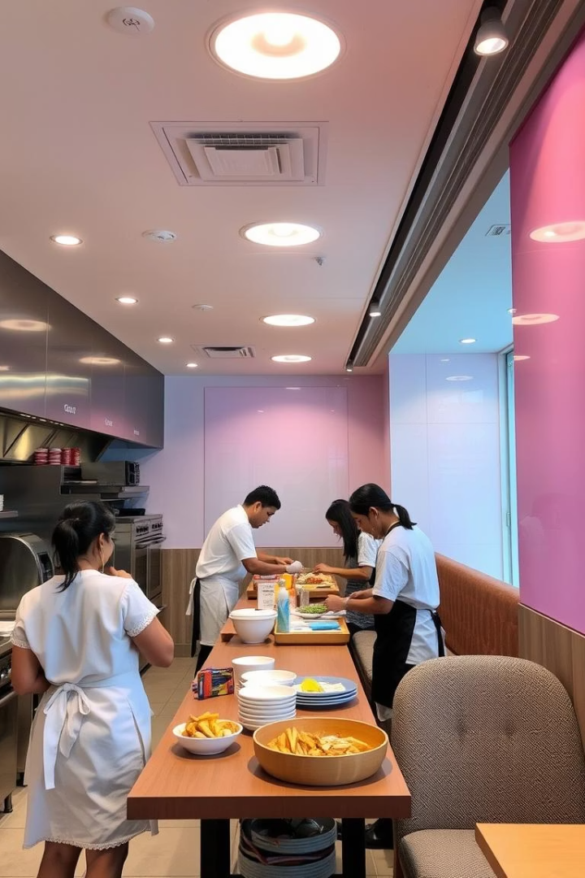
Bangalore's Efficiency Analysis
Restaurant Count
Bangalore has 109 restaurants compared to Mumbai's 115
Revenue Generation
Bangalore generates $3.4M compared to Mumbai's $3.5M
Order Volume
Bangalore handles 3.3K orders (22%) compared to Mumbai's 3.38K orders (22.56%)
Efficiency Ratio
Bangalore achieves nearly equal revenue with fewer restaurants
Insight: Bangalore shows remarkable efficiency — achieving close revenue to Mumbai with fewer restaurants.

Slide 8

Revenue by City
$3.5M
$3.4M
Mumbai
Bangalore
Highest revenue generator
Close second in revenue
$3.0M
$2.8M
Delhi
Kolkata & Chennai
Third highest revenue
Tied for fourth place
Insight: Revenue is proportional to order volumes, with Mumbai leading slightly. However, Bangalore shows remarkable efficiency — achieving close revenue to Mumbai with fewer restaurants.

Slide 9
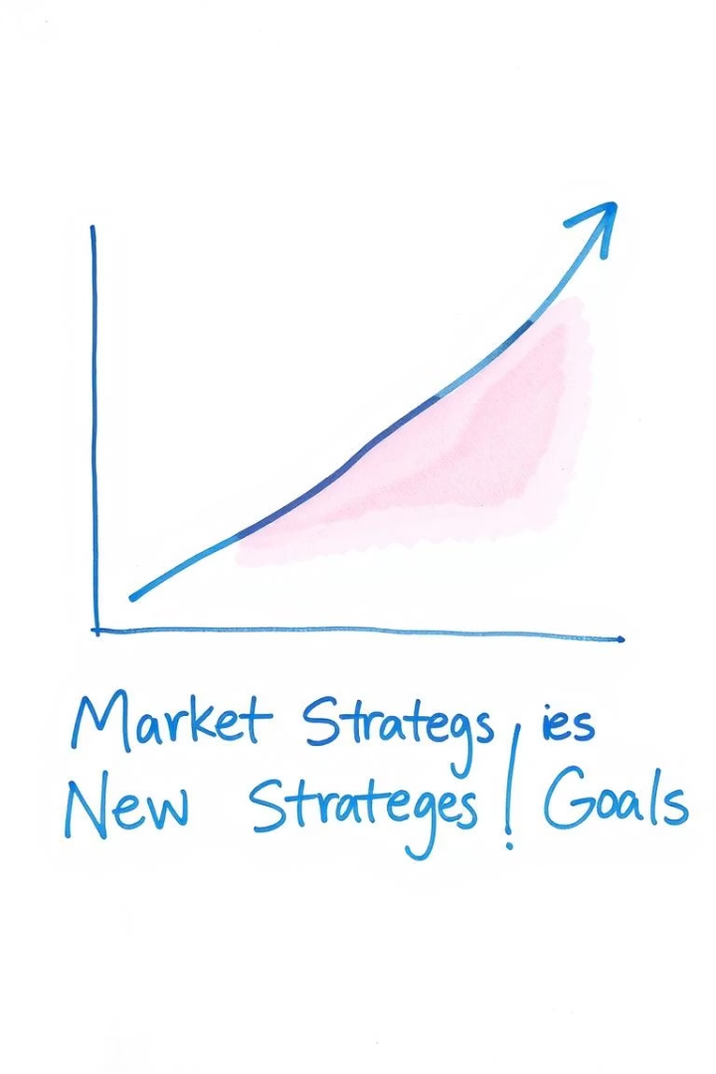
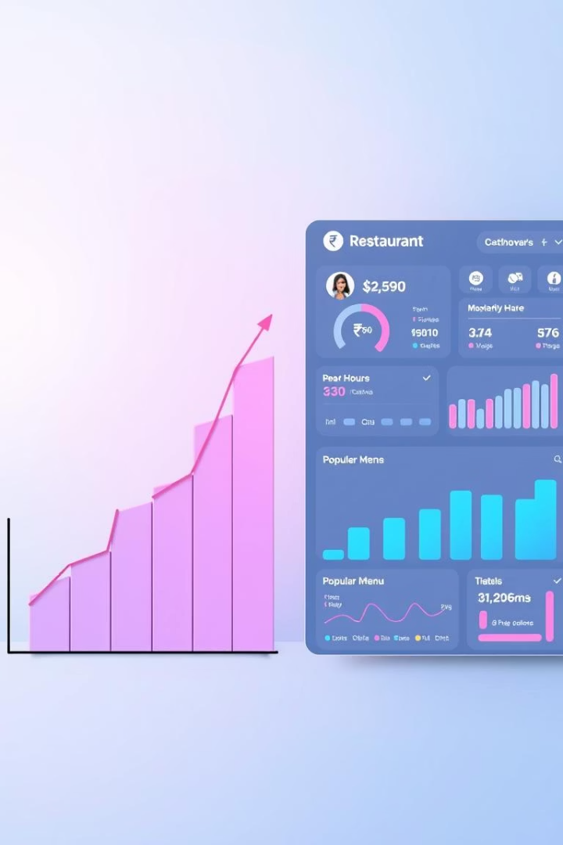



Revenue Growth Analysis
Current Total Revenue
$15.57M
Previous Revenue
$14.29M
Revenue Growth
+0.09% (a very marginal increase)
Insight: Growth is stagnating. Immediate action like introducing loyalty programs, new promotions, and tapping into new customer segments is needed to re-energize growth.

Slide 10










City-wise Performance
Delhi
Bangalore
Kolkata
Close behind the leaders
Strong performer with higher efficiency
Emerging market with growth potential
Mumbai
Chennai
Leading market with highest order volume
Competitive market requiring attention
Mumbai and Bangalore dominate, but Delhi, Kolkata, and Chennai are close behind.

Slide 11
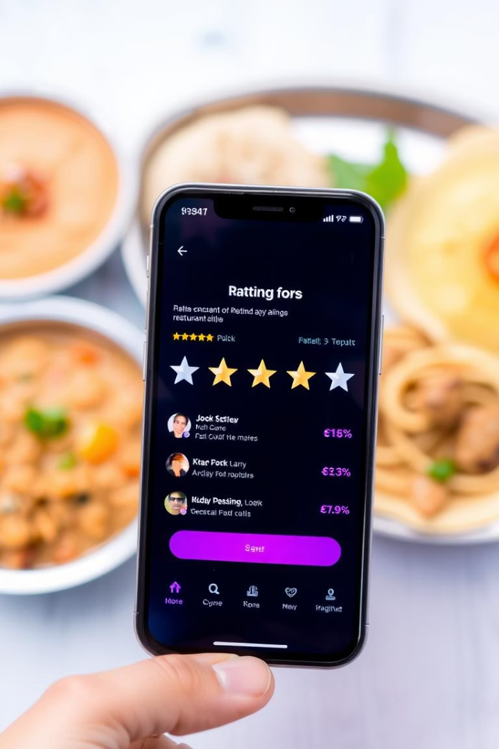


Customer Ratings Impact
Total Cost by Average Rating
Costs are higher for restaurants with better ratings (4–5 stars).
Delivery Time by Average Rating
Higher ratings correlate with slightly longer delivery times.
Total Ratings Distribution
Peak seen at 4.0–4.5 ratings — customers generally have a positive experience.
Insight: Quality (better food or service) drives better ratings and higher costs. Fast deliveries are important but not at the expense of quality.

Slide 12






Restaurant-wise Sales Summary
Restaurant_116
$51K
Restaurant_262, 56, 27
Each around $49K
Restaurant_127
$48K
High performers have relatively similar sales, indicating a competitive top tier.
Insight: Leading restaurants should be studied for best practices — menu pricing, delivery speed, customer experience — and their strategies could be scaled across others.

Slide 13





Summary of Critical Findings
City Distribution
Seasonal Trends
Growth Status
Mumbai and Bangalore dominate, but Delhi, Kolkata, and Chennai are close behind.
May and September are crucial high-sales months — plan heavy marketing campaigns.
Revenue is strong but growth is sluggish, indicating a market nearing maturity.
Quality Factors
Strategic Direction
Quality drives ratings and revenues, even if delivery times are marginally longer.
Best-performing restaurants could be templates for scaling successful strategies.

